Slide 1


Sebastian Rada
December 2025

Slide 2

Outline
Executive Summary
Introduction
Methodology
Results
Conclusion
Appendix

Slide 3
Executive Summary
Summary of methodologies Collected SpaceX launch data via API and web scraping, cleaned and prepared it, explored patterns using visualizations and SQL, built an interactive dashboard, and trained classification models (e.g., logistic regression, decision trees) to predict first-stage landing success.
Summary of all results Launch site, booster version, and payload mass were the strongest predictors. Models achieved roughly 80–90% accuracy, showing that newer boosters land more reliably and heavier payloads reduce success probability.

Slide 4
Introduction
Project background and context:
The project focuses on SpaceX’s Falcon 9 rockets, whose ability to land and be reused greatly reduces launch costs. As a data scientist for a competing company, your goal is to analyze SpaceX’s historical launches to understand what drives first-stage landing success.
Problems you want to find answers:
Which factors most influence landing success? How accurately can we predict whether a launch will land successfully? And how can these insights help estimate costs and improve competitive bidding on future launches?

Slide 5

Section 1

Slide 6
Methodology
Executive Summary
Data collection methodology
Perform data wrangling
Perform exploratory data analysis (EDA) using visualization and SQL
Perform interactive visual analytics using Folium and Plotly Dash
Perform predictive analysis using classification model

Slide 7
Data Collection
Combined SpaceX API data + Wikipedia web-scraped tables
Integrated multiple sources to build a complete launch dataset
Ensured consistency through cleaning, merging, and formatting
Output: final analytical dataset for EDA and ML modeling
SpaceX API ──►
\
► Data Extraction ─► Cleaning & Formatting─► Merged Dataset
/
Wikipedia ───►

Slide 8
Data Collection – SpaceX API
Used SpaceX REST API to retrieve historical Falcon 9 launch data
Extracted: launch dates, booster versions, payload mass, launch sites, landing outcomes
Queried endpoints using HTTP GET requests
Converted JSON responses into pandas DataFrames
Link
API Endpoint URL
│
▼
HTTP GET Request
│
▼
JSON Response
│
▼
Normalize & Load into DataFrame

Slide 9
Data Collection - Scraping
Scraped Wikipedia tables containing additional Falcon 9 launch info
Used BeautifulSoup to parse HTML and extract table rows
Cleaned and standardized fields not available in the API
Joined scraped data with API data to complete missing attributes
Link
Wikipedia Page URL
│
▼
HTML Download
│
▼
BeautifulSoup Parsing
│
▼
Table Extraction → Cleaning → DataFrame

Slide 10
Data Wrangling
Cleaned and standardized raw data from both API and web scraping
Converted data types and resolved missing or inconsistent values
Engineered new features relevant to landing prediction
Prepared a final, analysis-ready dataset for EDA and machine learning
Link

Slide 11
EDA with SQL
Inspected table structure
Filtered launches by launch site
Calculated total payload mass
Computed the average payload mass
Retrieved all distinct landing outcomes
Found the earliest date
Identified booster versions
Counted missions by mission outcome
Listed distinct mission outcomes
Selected booster version(s)
Extracted 2015 launches
Link

Slide 12
EDA with Data Visualization
Bar Charts: Compared landing success rates across launch sites and booster versions to identify which categories showed the highest performance
Scatter Plots: Explored the relationship between payload mass and landing outcome, helping detect trends or thresholds
Histograms: Examined distributions of payload mass and flight numbers to understand data spread and detect outliers
Box Plots: Compared payload distributions across orbits and launch sites to evaluate variability and differences among groups
Line Charts / Time Series: Visualized landing success over time to observe improvements in reliability across years
Link

Slide 13
Build an Interactive Map with Folium
Map Objects Created
Base Folium map centered on NASA JSC
Circle markers for each launch site
Text labels using DivIcon
Success/failure markers (green/red)
MarkerCluster to group overlapping points
Link
Porpuse
Highlight and label launch sites
Visualize landing outcomes clearly
Reduce clutter with clustering
Analyze geographic factors (distance)

Slide 14
Build a Dashboard with Plotly Dash
Plots and Interactions Added
Pie Chart (All Sites): Shows total number of successful launches across all SpaceX launch sites
Pie Chart (Selected Site): Displays success vs. failure outcomes for a specific launch site chosen from the dropdown
Scatter Plot: Plots payload mass vs. launch success, colored by booster version category
Dropdown Menu: Allows users to select a specific launch site or view all sites
Range Slider: Lets users filter launches by payload mass range
Link

Slide 15
Predictive Analysis (Classification)
I built the classification model by first cleaning and standardizing the dataset, then splitting it into training and testing subsets. Using GridSearchCV, I trained four algorithms—Logistic Regression, SVM, Decision Tree, and KNN—while tuning their hyperparameters through cross-validation to identify the best settings. After evaluating each model on validation and test sets, I compared their accuracies and confusion matrices. The Decision Tree achieved the highest validation score, but Logistic Regression, SVM, and KNN performed more consistently on the test set, making them the most reliable models overall
Link

Slide 16
Results
EDA Results
Success rates vary by launch site and booster version
Payload has a moderate relationship with landing success
Newer boosters show higher reliability
Interactive Dashboard
Dropdown selects site; slider filters payload
Pie charts show site performance; scatter shows payload vs. success
All graphs update dynamically for exploration
Predictive Analysis
Trained Logistic Regression, SVM, KNN, Decision Tree
Tuned with GridSearchCV; compared accuracy
SVM and Logistic Regression were the most reliable models

Slide 17

Section 2

Slide 18
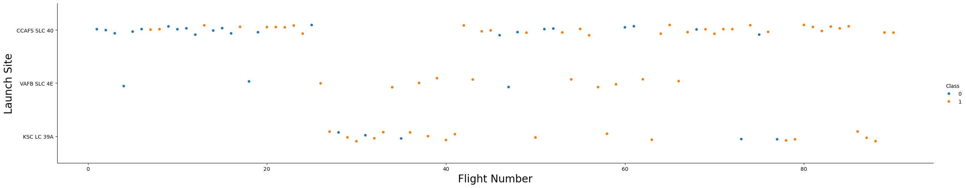
Flight Number vs. Launch Site
This scatter plot shows how launch success (orange dots) and failure (blue dots) are distributed across flight numbers for each SpaceX launch site. Each row represents a different launch site, and each point represents one launch. The graph reveals that most later flights tend to be successful, especially at CCAFS SLC 40 and KSC LC 39A, suggesting improved reliability over time. The VAFB SLC 4E site has fewer launches but shows a similar pattern of increasing success

Slide 19
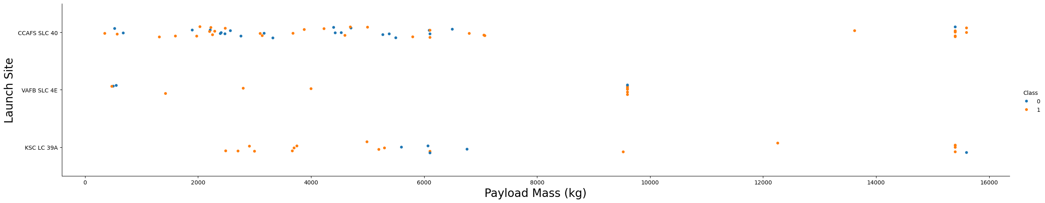
Payload vs. Launch Site
This plot shows launch outcomes across different payload masses and sites. Orange points (success) appear across the full payload range, while failures (blue) cluster in fewer areas. Overall, success remains high even at heavier payloads, suggesting payload mass is not a major limiting factor

Slide 20
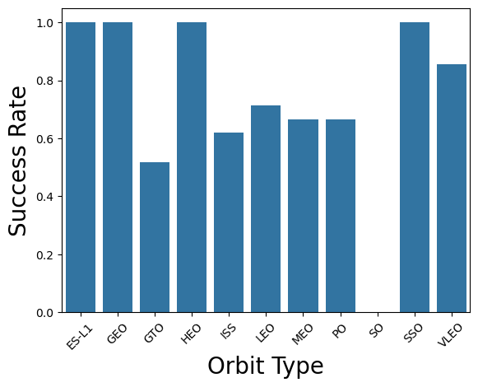
Success Rate vs. Orbit Type
This bar chart shows the launch success rate for each orbit type. Most orbit categories such as ES-L1, GEO, HEO, and SSO have very high success rates, while GTO stands out with a lower success rate
Overall, success remains strong across most orbits with some variation depending on mission type

Slide 21
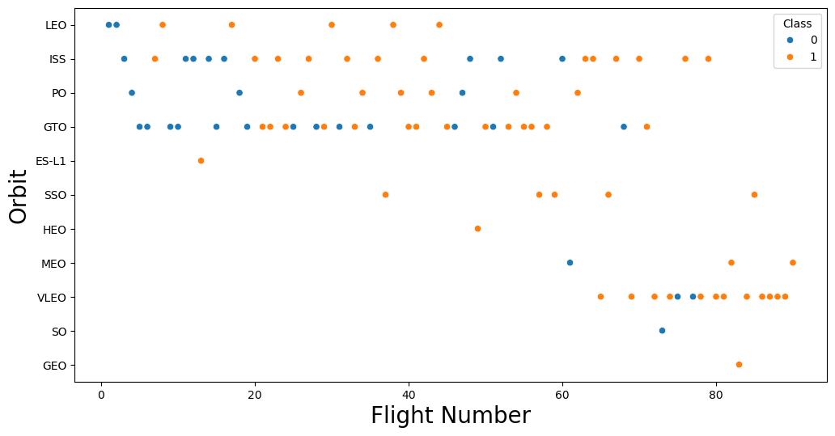
Flight Number vs. Orbit Type
This plot shows launch outcomes across different orbit types and flight numbers. Orange points represent successful landings and blue points represent failures
Most orbits show a high concentration of successful launches, especially in later flights, which suggests performance improves over time

Slide 22
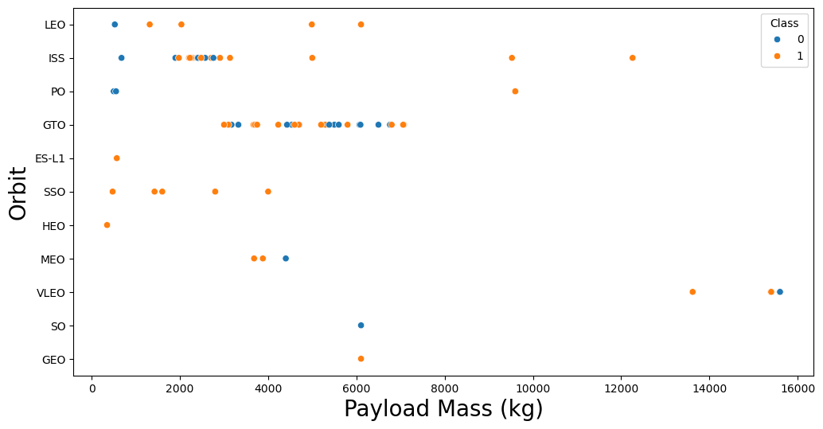
Payload vs. Orbit Type
Shows payload mass (x-axis) vs. orbit type (y-axis)
Two colors represent two launch classes (0 and 1)
Lets you compare how each class is distributed across different orbits
Insight: Class 1 tends to handle heavier payloads, especially above ~10,000 kg
Insight: LEO and GTO have the highest concentration of launches from both classes

Slide 23
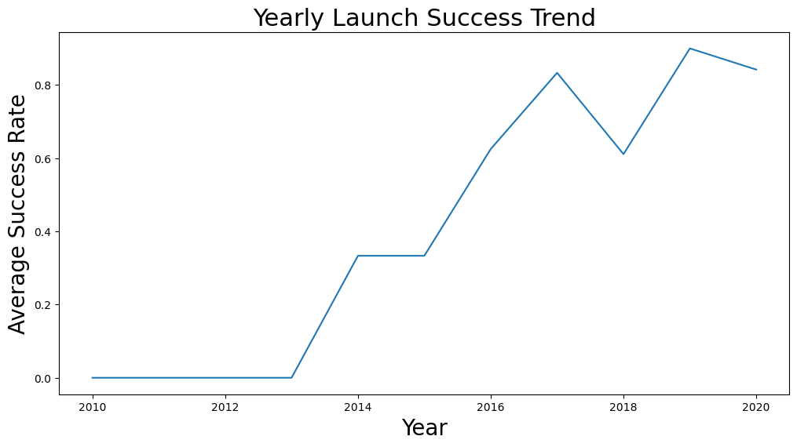
Launch Success Yearly Trend
Line chart showing average launch success rate per year (2010–2020)
Success rate starts at 0, then steadily increases after 2013
Peaks around 2019, with a slight dip in 2020
Insight: The success rate shows a clear upward trend, suggesting major reliability improvements over the decade

Slide 24
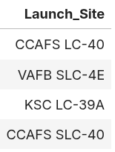
All Launch Site Names
SELECT DISTINCT "Launch_Site" removes duplicates, giving a clean list of all different launch locations used in the dataset

Slide 25
Launch Site Names Begin with 'CCA'
Columns:
Date, Time (UTC), Booster_Version, Launch_Site, Payload, PAYLOAD_MASS__KG_, Orbit, Customer, Mission_Outcome, Landing_Outcome
Explanation:
These columns appear in the query output because the SELECT * statement returns every field from rows where Launch_Site begins with "CCA", limited to the first 5 matching launches

Slide 26
Total Payload Mass
Query Result: Total payload mass carried by boosters for NASA (CRS) missions: 45,596 kg
Explanation: The query uses SUM(PAYLOAD_MASS__KG_) to add up all payload masses from rows where the customer is NASA (CRS), giving the total payload delivered for their resupply missions

Slide 27
Average Payload Mass by F9 v1.1
Query Result: Average payload mass for booster version F9 v1.1: 2928.4 kg
Explanation: The query calculates the mean payload mass by selecting only rows where the booster version is F9 v1.1 and applying AVG() to the payload mass column.

Slide 28
First Successful Ground Landing Date
Query Result: 2015-12-22
Explanation: Filtering the table to rows where Landing_Outcome = 'Success (ground pad)' and selecting the earliest date gives December 22, 2015, which is the first successful Falcon 9 ground-pad landing.

Slide 29
Successful Drone Ship Landing with Payload between 4000 and 6000
Query Result:
F9 FT B1022
F9 FT B1026
F9 FT B1021.2
F9 FT B1031.2
Explanation: These boosters meet all three conditions:
Successful drone-ship landing
Payload mass between 4000 and 6000 kg.
The query filters for those criteria and returns the matching booster names.

Slide 30
Total Number of Successful and Failure Mission Outcomes
Query Result:
Successful missions: 100
Failed missions: 1
Explanation:nFrom the grouped results:
Success appears in three forms (Success, Success , and Success (payload status unclear)), totaling 100 successful missions.
Only 1 mission is marked as Failure (in flight) → counted as failure.

Slide 31
Boosters Carried Maximum Payload
Query Result:
F9 B5 B1048.4
F9 B5 B1049.4
F9 B5 B1051.3
F9 B5 B1056.4
F9 B5 B1048.5
F9 B5 B1051.4
F9 B5 B1049.5
F9 B5 B1060.2
F9 B5 B1058.3
F9 B5 B1051.6
F9 B5 B1060.3
F9 B5 B1049.7
​ Explanation:​ These boosters all carried the maximum payload mass recorded in the dataset.​ The inner query finds the highest payload value, and the outer query returns all boosters that match that maximum.

Slide 32
2015 Launch Records
Query Result:
January — F9 v1.1 B1012 — CCAFS LC-40 — Failure (drone ship)
April — F9 v1.1 B1015 — CCAFS LC-40 — Failure (drone ship)
Explanation: The query filters for launches in 2015 where the landing outcome was “Failure (drone ship)”, then extracts the month name, booster version, and launch site. Two such failures occurred that year.

Slide 33

Section 3

Slide 34
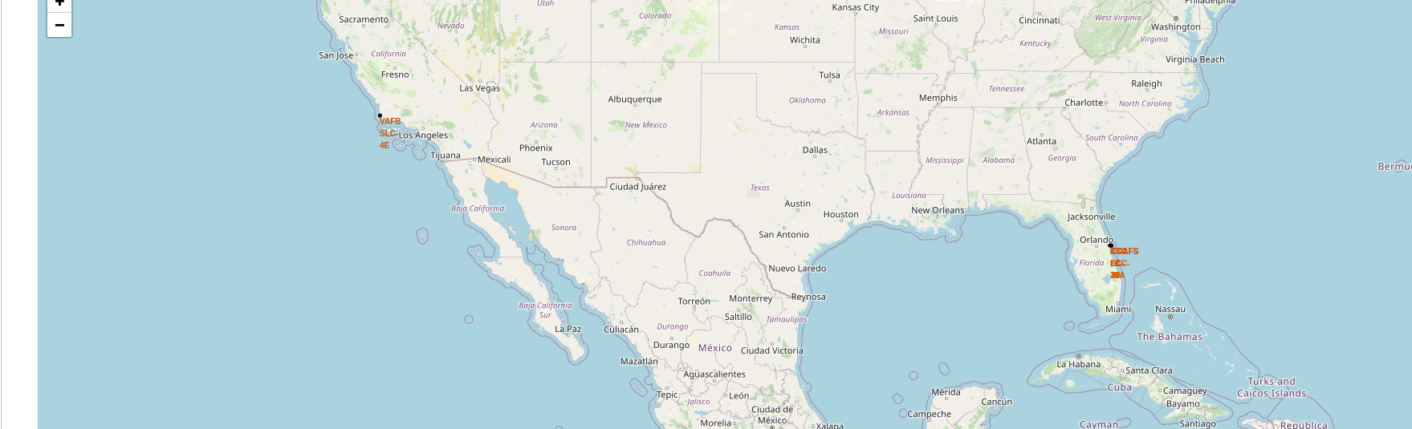
Global Map of SpaceX Launch Site Locations
The map shows all SpaceX launch sites from the dataset. Three sites appear:
VAFB SLC-4E (California)
CCAFS LC-40 (Florida)
KSC LC-39A (Florida)
All launch sites are located in the United States.
Florida sites appear close together because they are only a few kilometers apart.
West Coast is used mainly for polar orbits, while East Coast supports most other missions.

Slide 35
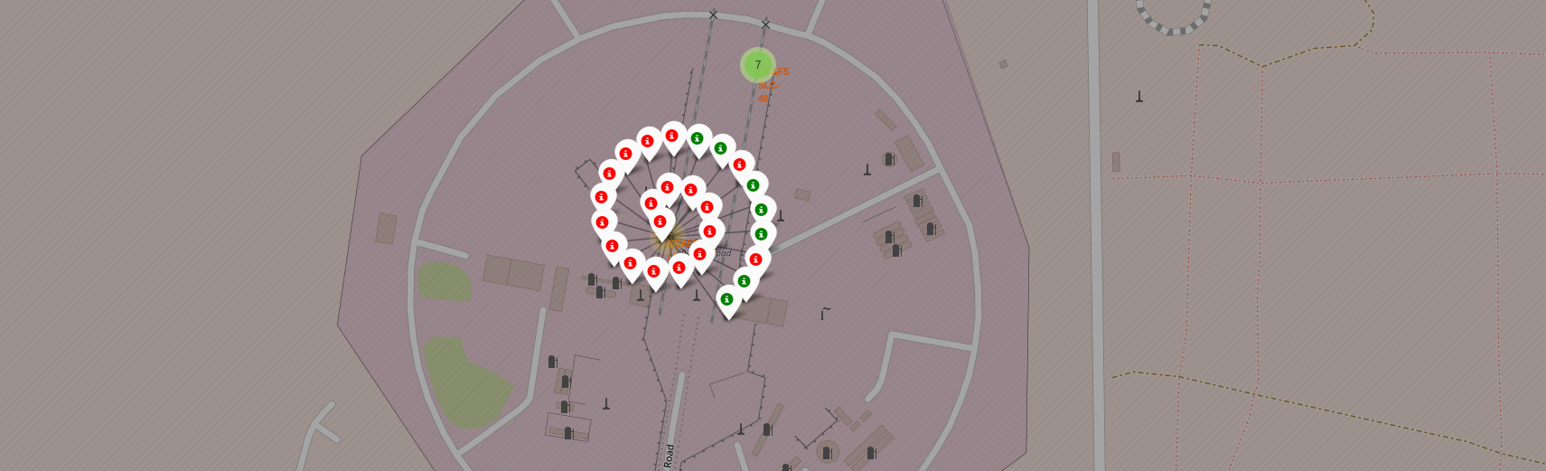
Color-Coded Launch Outcomes at CCAFS and KSC Launch Sites
Each marker represents a Falcon 9 launch, color-coded by landing outcome:
Green markers → Successful landing
Red markers → Failed landing
The MarkerCluster groups markers into a spiral-like cluster when zoomed in, making dense launch activity easy to visualize.
Green markers grow in frequency over time, reflecting SpaceX’s increasing landing reliability.

Slide 36

Section 4

Slide 37
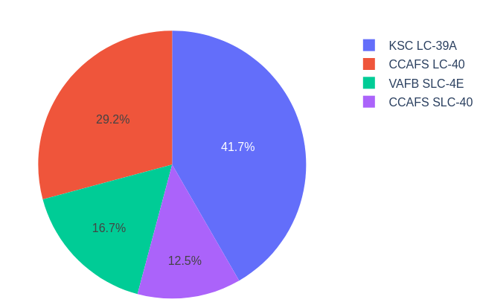
Launch Success Distribution Across All SpaceX Sites
KSC LC-39A has the highest number of successful launches.
CCAFS LC-40 also contributes a large share of successes.
VAFB SLC-4E shows fewer successes due to fewer missions.

Slide 38
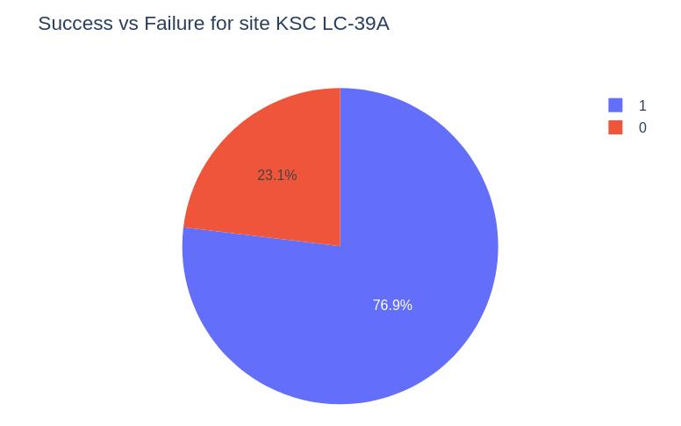
Success vs Failure Breakdown for KSC LC-39A
The pie chart shows successful launches (1) vs failed launches (0) at KSC LC-39A.
KSC LC-39A has a high success ratio (≈77%), making it the top-performing launch site.
Failures are relatively few, representing only about 23% of launches.
This confirms LC-39A as SpaceX’s most reliable site in the dataset.

Slide 39
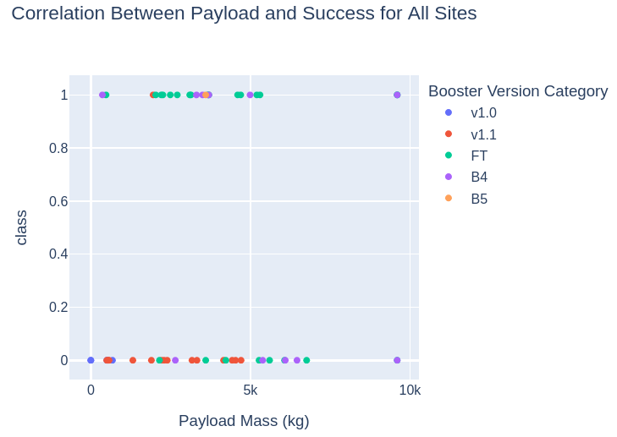
Payload vs Launch Outcome
Successes occur across almost all payload levels, from very low to nearly 10,000 kg.
FT (Full Thrust) and B4 boosters show many successful launches, indicating high reliability.
Most failures happen in the lower to mid payload range (0–6000 kg) and with older boosters (v1.0, v1.1).
There is no strong correlation between payload mass and success — booster version matters more than payload weight.

Slide 40

Section 5

Slide 41
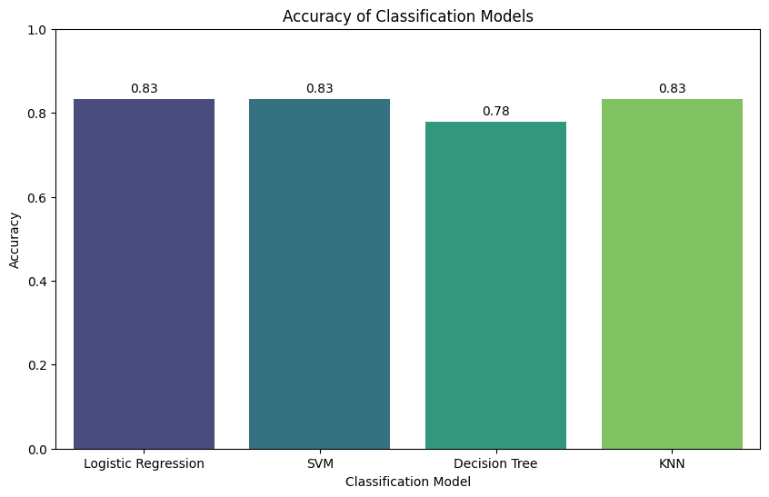
Classification Accuracy
Logistic Regression, SVM, and KNN all achieve 0.83 accuracy.
Decision Tree performs slightly lower at 0.78.
Overall, three models tie for the best performance.

Slide 42

Confusion Matrix
Correct predictions: 3 for “did not land” and 12 for “landed.”
The model misclassified 3 cases as “landed” when they actually “did not land.”
No false negatives: the model never predicted “did not land” for a true landing.

Slide 43
Conclusions
This capstone project demonstrated the full data science workflow — from data collection and cleaning to exploratory analysis, visualization, modeling, and evaluation.
Using real SpaceX launch data, we explored key factors that influence Falcon 9 landing success, including launch site, payload mass, and booster version.
Visual analyses showed that some launch sites, such as KSC LC-39A, consistently achieve higher success rates, and that newer booster versions tend to perform better.
Machine learning models (Logistic Regression, SVM, Decision Tree, and KNN) were built to predict landing outcomes.
Most models achieved strong performance, with Logistic Regression, SVM, and KNN reaching 83% accuracy.
The confusion matrix revealed that the selected model is particularly strong at predicting successful landings, with very few misclassifications.

Slide 44


